Slide 1
Why learning R? R is open source, so it’s free. R is cross-platform compatible, so it can be installed on Windows, MAC OSX and Linux R provides a wide variety of statistical techniques and graphical capabilities. R provides the possibility to make a reproducible research by embedding script and results in a single file. R has a vast community both in academia and in business R is highly extensible and it has thousands of well-documented extensions (named R packages) for a very broad range of applications in the financial sector, health care,… It’s easy to create R packages for solving particular problems

Slide 2
Install R and RStudio on windows
Install R for windows
Install Rtools for Windows
Install RStudio on Windows
Install R and RStudio for MAC OSX
Install R and RStudio on Linux

Slide 3
Install R and RStudio on windows
Install R for windows
Download the latest version of R, for Windows, from CRAN at : https://cran.r-roject.org/bin/windows/base/
Double-click on the file you just downloaded to install R
Cick ok –> Next –> Next –> Next …. (no need to change default installation parameters)

Slide 4
Install RStudio on Windows
Download RStudio at : https://www.rstudio.com/products/rstudio/download/

Slide 5
Install R and RStudio for MAC OSX
Download the latest version of R, for MAC OSX, from CRAN at : https://cran.r-project.org/bin/macosx/
Double-click on the file you just downloaded to install R
Cick ok –> Next –> Next –> Next …. (no need to change default installation parameters)
Download and install the latest version of RStudio for MAC at: https://www.rstudio.com/products/rstudio/download/

Slide 6
Install R and RStudio on Linux
R can be installed on Ubuntu, using the following Bash script:
sudo apt-get install r-base
RStudio for Linux is available at
https://www.rstudio.com/products/rstudio/download/

Slide 7
In an R Session…
First, read data from other sources
Use packages, libraries, and functions
Write functions wherever necessary
Conduct Statistical Data Analysis
Save outputs to files, write tables
Save R workspace if necessary (exit prompt)
Notes:
In general, when we work in an R session for doing statistical analysis, we first read the data, then use one or more packages, libraries, or sets of functions to work on the dataset. We can also write our own functions to accomplish specific tasks. We create outputs and create graphs and graphics. Save our work to a file or several files and terminate the R session. For terminate an R session, type “quit()” (note, even quit is a function), and the program asks you if it can save the R session. If you order “yes”, the session is saved as an .Rdata file and is available at a subsequent session.

Slide 8
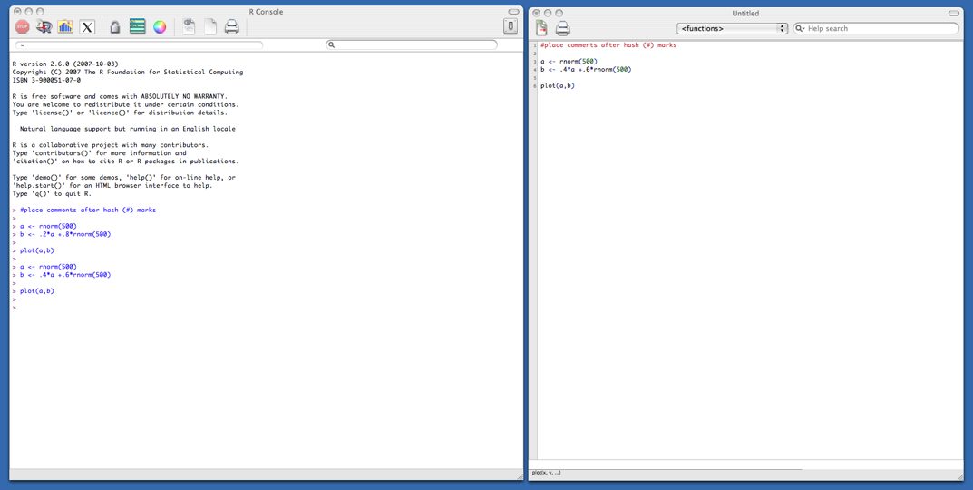
session
Start up R via the GUI or favorite text editor
Two windows:
1+ new or existing scripts (text files) - these will be saved
Terminal – output & temporary input - usually unsaved

Slide 9
Typical R session
R sessions are interactive
Write small bits of code here and run it

Slide 10
Typical R session
R sessions are interactive
Write small bits of code here and run it
Output appears here. Did you get what you wanted?

Slide 11
Typical R session
R sessions are interactive
Output appears here. Did you get what you wanted?
Adjust your syntax here depending on this answer.

Slide 12
Typical R session
R sessions are interactive

Slide 13
Typical R session
R sessions are interactive
At end, all you need to do is save your script file(s) - which can easily be rerun later.

Slide 14
R Warning !
R is a case sensitive language.
FOO, Foo, and foo are three different objects

Slide 15
R code
> log(2)
[1] 0.6931472
> x = 5
> y = 10
> z <- x+y
> z
[1] 15
> seq(1,5, by=.5)
[1] 1.0 1.5 2.0 2.5 3.0 3.5 4.0 4.5 5.0
> 2+2
[1] 4
> 2+2^2
[1] 6
> (2+2)^2
[1] 16
> sqrt(2)
[1] 1.414214

Slide 16
Data Types
R has a wide variety of data types including scalars, vectors (numerical, character, logical), matrices, dataframes, and lists.

Slide 17
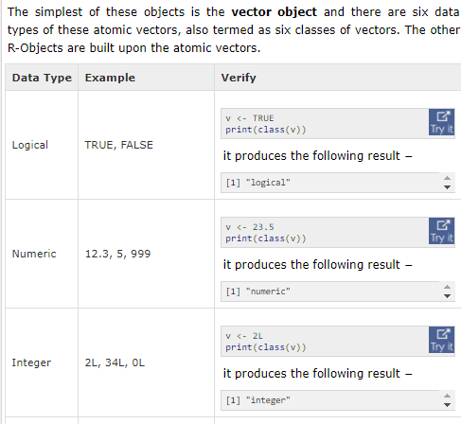

Slide 18
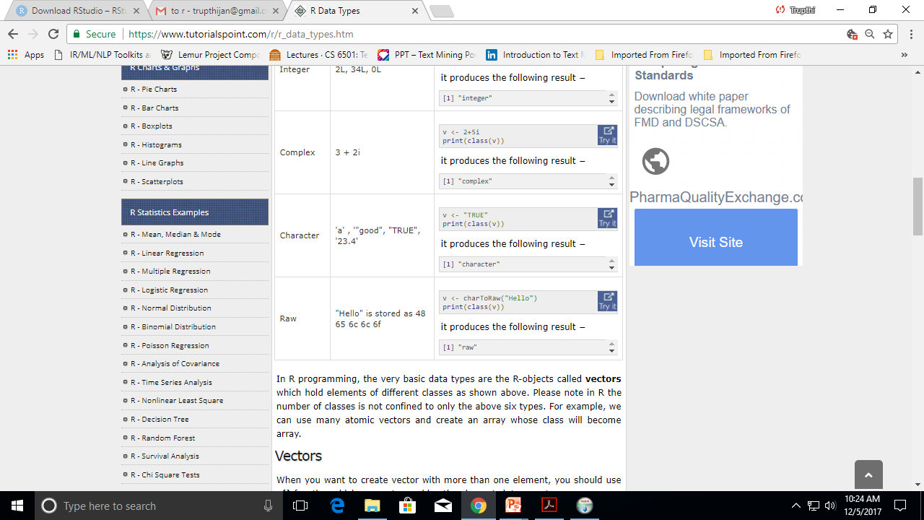

Slide 19
Vectors- To create vector with more than one element, c() function which means to combine the elements into a vector.
# Create a vector
apple <- c(“red”,”green”,"yellow")
print(apple) [1] "red" "green" "yellow"
# Get the class of the vector.
print(class(apple)) [1] "character"
a <- c(1,2,5.3,6,-2,4) # numeric vector
b <- c("one","two","three") # character vector
c <- c(TRUE,TRUE,TRUE,FALSE,TRUE,FALSE)
#logical vector
Refer to elements of a vector using subscripts.
a[c(2,4)] # 2nd and 4th elements of vector

Slide 20
R Code
> v1 = c(6,5,4,3,2,1)
> v1
[1] 6 5 4 3 2 1
> v2 = c(10,9,8,7,6,5)
> V2
> v3 = v1 + v2
> v3
[1] 16 14 12 10 8 6

Slide 21
R code
> max(v3);min(v3)
[1] 16
[1] 6
> length(v3)
[1] 6
> mean(v3)
[1] 11
> sd(v3)
[1] 3.741657

Slide 22
Matrices
All columns in a matrix must have the same mode(numeric, character, etc.) and the same length.
# Create a matrix.
M = matrix( c('a','a','b','c','b','a'), nrow = 2, ncol = 3, byrow = TRUE) print(M)
mymatrix <- matrix(vector, nrow=r, ncol=c, byrow=FALSE,dimnames=list(char_vector_rownames, char_vector_colnames))
byrow=TRUE indicates that the matrix should be filled by rows. byrow=FALSE indicates that the matrix should be filled by columns (the default). dimnames provides optional labels for the columns and rows.

Slide 23
Matrices
# generates 5 x 4 numeric matrix y<-matrix(1:20, nrow=5,ncol=4)
# another example cells <- c(1,26,24,68) rnames <- c("R1", "R2") cnames <- c("C1", "C2") mymatrix <- matrix(cells, nrow=2, ncol=2, byrow=TRUE, dimnames=list(rnames, cnames))
#Identify rows, columns or elements using subscripts.
x[,4] # 4th column of matrix x[3,] # 3rd row of matrix x[2:4,1:3] # rows 2,3,4 of columns 1,2,3

Slide 24
Arrays
Arrays are similar to matrices but can have more than two dimensions. See help(array) for details.
# Create an array.
a <- array(c('green','yellow'),dim = c(3,3,2)) print(a)

Slide 25
Data frames
A data frame is more general than a matrix, in that different columns can have different modes (numeric, character, factor, etc.).
d <- c(1,2,3,4)
e <- c("red", "white", "red", NA)
f <- c(TRUE,TRUE,TRUE,FALSE)
mydata <- data.frame(d,e,f)
names(mydata) <- c("ID","Color","Passed") #variable names

Slide 26
Data frames
There are a variety of ways to identify the elements of a dataframe .
mydata[1:2] # columns 1,2 of dataframe
mydata[c("ID","Color")] # columns ID and Age from dataframe
mydata$ID # variable x1 in the dataframe

Slide 27
Lists
A list is an R-object which can contain many different types of elements inside it like vectors, functions and even another list inside it.
# Create a list.
list1 <- list(c(2,5,3),21.3,sin)
# Print the list. print(list1)
[[1]] [1] 2 5 3
[[2]] [1] 21.3
[[3]] function (x) .Primitive("sin")

Slide 28
An ordered collection of objects (components). A list allows you to gather a variety of (possibly unrelated) objects under one name.
# example of a list with 4 components - # a string, a numeric vector, a matrix, and a scalar
w <- list(name="Fred", mynumbers=a, mymatrix=y, age=5.3)

Slide 29
Lists
# example of a list containing two lists v <- c(list1,list2)
Identify elements of a list using the [[]] convention.
mylist[[2]] # 2nd component of the list

Slide 30
n = c(2, 3, 5)
s = c("aa", "bb", "cc", "dd", "ee")
b = c(TRUE, FALSE, TRUE, FALSE, FALSE)
x = list(n, s, b, 3) # x contains copies of n, s, b
x

Slide 31
List Slicing
We retrieve a list slice with the single square bracket "[]" operator. The following is a slice containing the second member of x, which is a copy of s.
> x[2] [[1]] [1] "aa" "bb" "cc" "dd" "ee"

Slide 32
With an index vector, we can retrieve a slice with multiple members. Here a slice containing the second and fourth members of x.
> x[c(2, 4)] [[1]] [1] "aa" "bb" "cc" "dd" "ee" [[2]] [1] 3

Slide 33
Member Reference
In order to reference a list member directly, we have to use the double square bracket "[[]]"operator. The following object x[[2]] is the second member of x. In other words, x[[2]] is a copy of s, but is not a slice containing s or its copy.
> x[[2]] [1] "aa" "bb" "cc" "dd" "ee"

Slide 34
We can modify its content directly.
> x[[2]][1] = "ta" > x[[2]] [1] "ta" "bb" "cc" "dd" "ee" > s [1] "aa" "bb" "cc" "dd" "ee" # s is unaffected

Slide 35
Keyboard Input
# create a dataframe from scratch age <- c(25, 30, 56) gender <- c("male", "female", "male") weight <- c(160, 110, 220) mydata <- data.frame(age,gender,weight)

Slide 36
Keyboard Input
You can also use R's built in spreadsheet to enter the data interactively, as in the following example.
# enter data using editor mydata <- data.frame(age=numeric(0), gender=character(0), weight=numeric(0)) mydata <- edit(mydata) # note that without the assignment in the line above, # the edits are not saved!

Slide 37
Viewing Data
There are a number of functions for listing the contents of an object or dataset.
# list objects in the working environment ls()
# list the variables in mydata names(mydata)
# list the structure of mydata str(mydata)
# list levels of factor v1 in mydata levels(mydata$v1)
# dimensions of an object dim(object)

Slide 38
Viewing Data
There are a number of functions for listing the contents of an object or dataset.
# class of an object (numeric, matrix, dataframe, etc) class(object)
# print mydata mydata
# print first 10 rows of mydata head(mydata, n=10)
# print last 5 rows of mydata tail(mydata, n=5)

Slide 39
Data Input
Data Types
Importing Data
Keyboard Input
Database Input
Exporting Data
Viewing Data
Variable Labels
Value Labels
Missing Data
Date Values

Slide 40
Factors
Tell R that a variable is nominal by making it a factor. The factor stores the nominal values as a vector of integers in the range [ 1... k ] (where k is the number of unique values in the nominal variable), and an internal vector of character strings (the original values) mapped to these integers.
# variable gender with 20 "male" entries and
# 30 "female" entries gender <- c(rep("male",20), rep("female", 30)) gender <- factor(gender)
# stores gender as 20 1s and 30 2s and associates
# 1=female, 2=male internally (alphabetically)
# R now treats gender as a nominal variable summary(gender)

Slide 41
R Datasets
R comes with a number of sample datasets that you can experiment with. Type
> data( )
to see the available datasets. The results will depend on which packages you have loaded. Type
help(datasetname)
for details on a sample dataset.

Slide 42
R Packages
One of the strengths of R is that the system can easily be extended. The system allows you to write new functions and package those functions in a so called `R package' (or `R library'). The R package may also contain other R objects, for example data sets or documentation. There is a lively R user community and many R packages have been written and made available on CRAN for other users. Just a few examples, there are packages for portfolio optimization, drawing maps, exporting objects to html, time series analysis, spatial statistics and the list goes on and on.

Slide 43
R Packages
When you download R, already a number (around 30) of packages are downloaded as well. To use a function in an R package, that package has to be attached to the system. When you start R not all of the downloaded packages are attached, only seven packages are attached to the system by default. You can use the function search to see a list of packages that are currently attached to the system, this list is also called the search path.
> search()
[1] ".GlobalEnv" "package:stats" "package:graphics"
[4] "package:grDevices" "package:datasets" "package:utils"
[7] "package:methods" "Autoloads" "package:base"

Slide 44
R Packages
To attach another package to the system you can use the menu or the library function. Via the menu:
Select the `Packages' menu and select `Load package...', a list of available packages on your system will be displayed. Select one and click `OK', the package is now attached to your current R session. Via the library function:
> library(MASS)
> shoes
$A
[1] 13.2 8.2 10.9 14.3 10.7 6.6 9.5 10.8 8.8 13.3
$B
[1] 14.0 8.8 11.2 14.2 11.8 6.4 9.8 11.3 9.3 13.6

